Slide 1



FINAL EXAM
8 Dec 2024
Phuc-Loi Luu, PhD
Luu.p.loi@googlemail.com
THE 3rd VIETNAM SCHOOL OF BIOLOGY (VSOB-3)
Bioinformatic Analysis For Bulk RNAseq Data
December 06th-08th, 2024, ICISE, Quy Nhon, Vietnam

Slide 2
Part 1: Fill in the blanks

Slide 3
Matching column A and B
1.1
Answer | No. A | A | No. B | B
 | A | <3% of the genome is subsequently translated into proteins genes which are? | 1 | Poly A tails
 | B | Non-coding RNAs cover a wide range of functions including protein assembly and ? | 2 | rRNA
 | C | miRNAs | 3 | Coding or non-coding genes
 | D | Pathway enrichment analysis, gene ontology analysis and functional analysis | 4 | Affymetrix
 | E | Gene Expression microarray | 5 | FastQC and Trimmomatic
 | F | BWA, Bowtie and Stampy | 6 | 18-23bp
 | G | mRNAs | 7 | Measure gene expression
 | H | Reference-independent | 8 | Unspliced aligner
 | I | featureCounts | 9 | g:Profile, GSEA and DAVID
 | J | qRT/PCR, Northern blotting, FISH, microarray, RNA-seq | 10 | Gene-level quantification
 | K | Preprocessing | 11 | gene expression regulation
 | L | 90-95% | 12 | Trinity, Oases and transABySS
 | M | Spliced aligner | 13 | STAR and TopHat

Slide 4
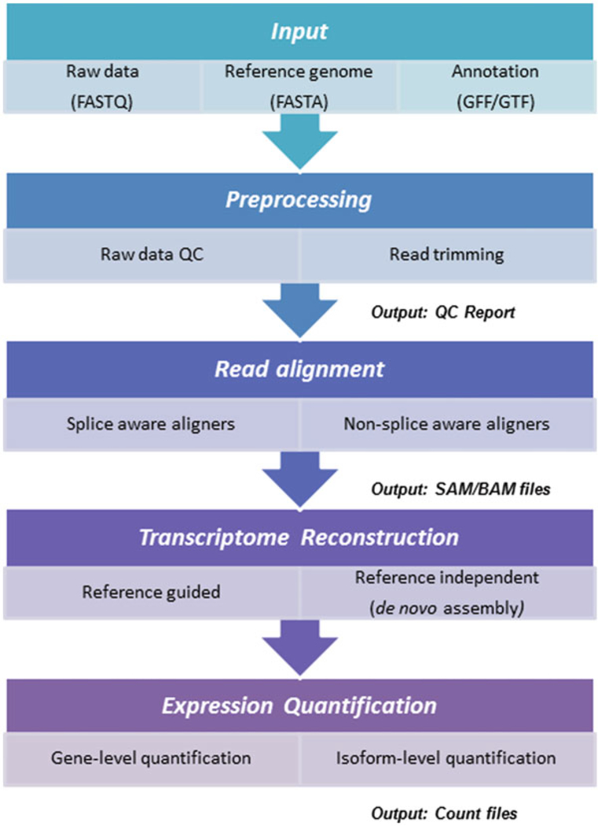
Fill in the blanks
1.2
1
2
Please fill in the blanks with the numbers
3
4
5
6
7
8

Slide 5
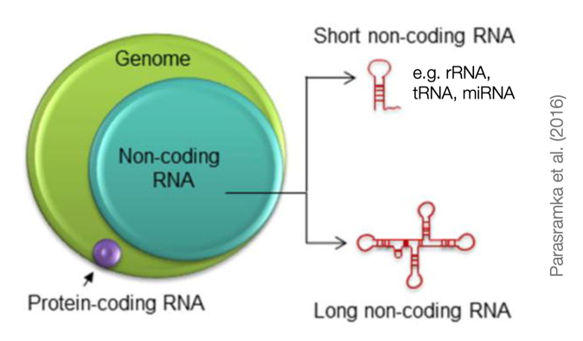
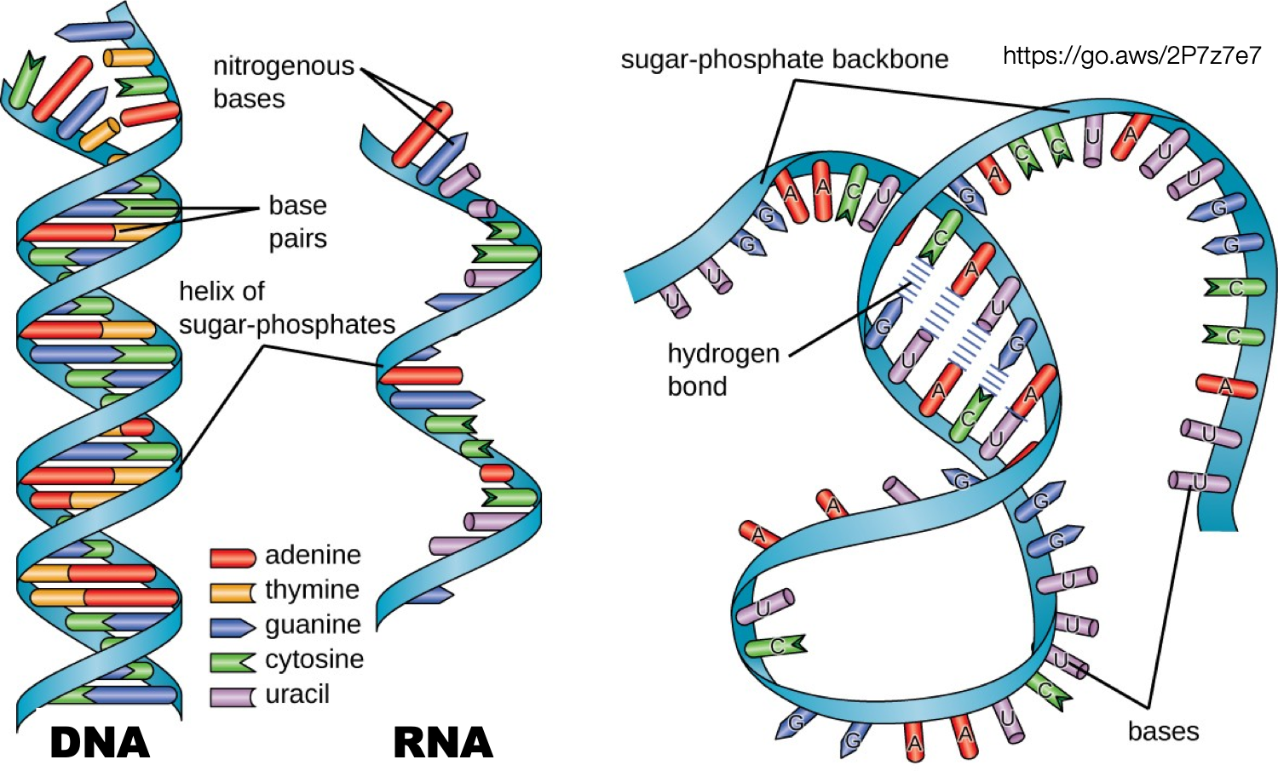
Fill in the blanks
1.3
7
1
2
8
5
6
3
4

Slide 6
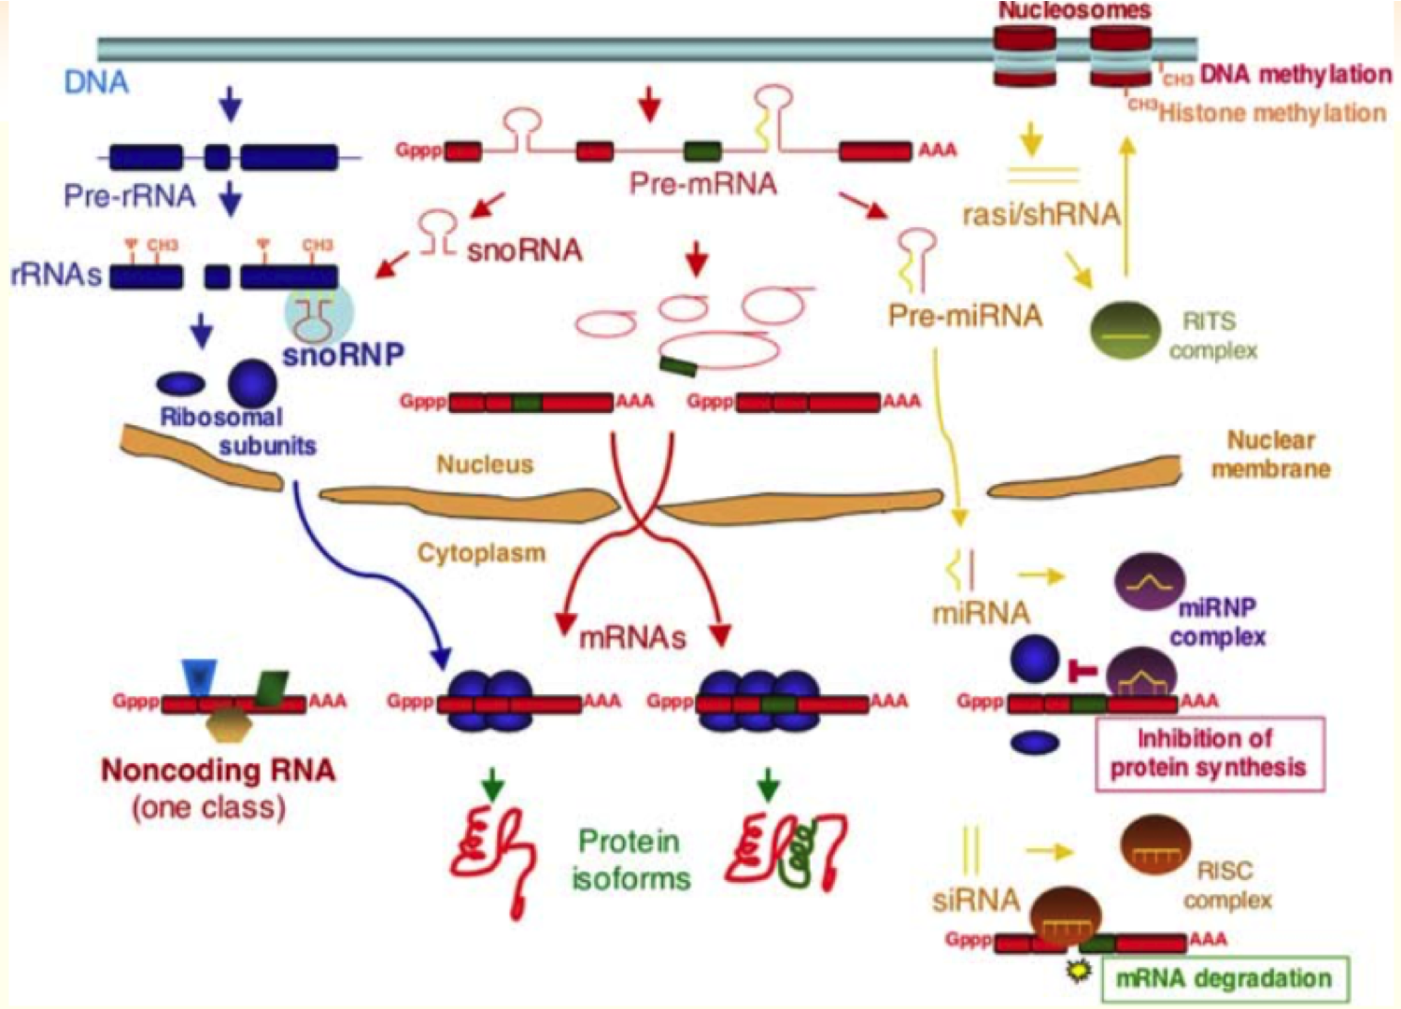
Fill in the blanks
1.4
1
2
3
5
4

Slide 7
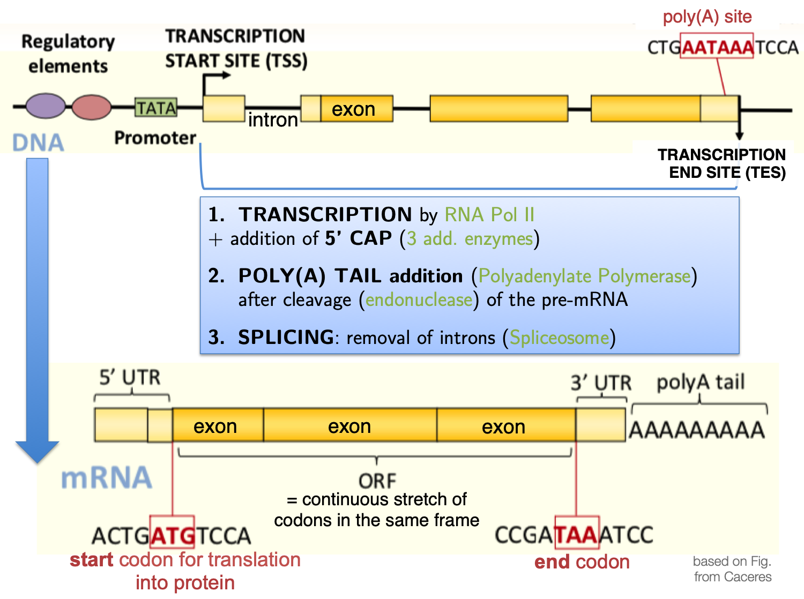
Fill in the blanks
1.5
4
2
3
1
5

Slide 8
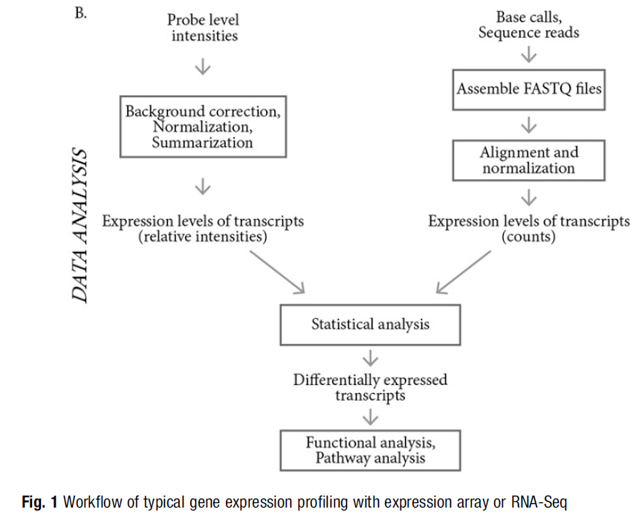
Fill in the blanks
1.6
1
2
3
3
4
5
10.1007/978-1-4939-7834-2_2
1
2

Slide 9
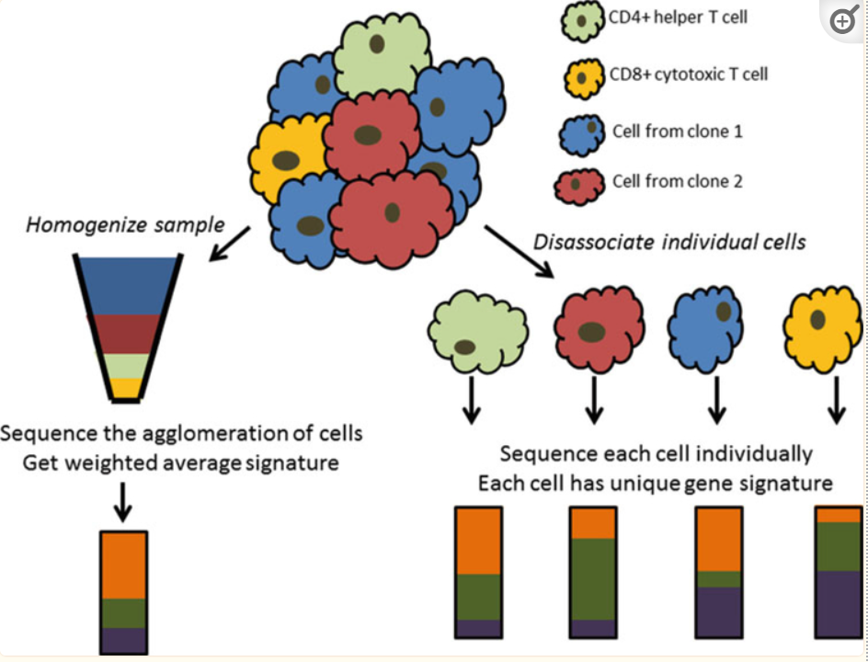
Fill in the blanks
1.7
1
2
3

Slide 10
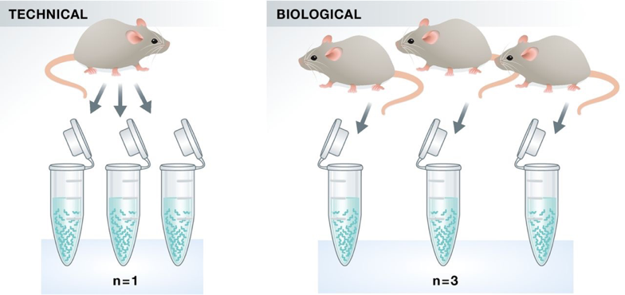
Fill in the blanks
1.8
1
2
3
4

Slide 11
Part 2: Explain Question

Slide 12
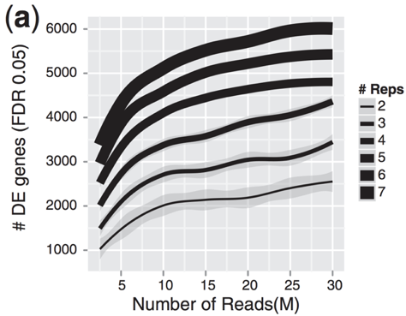
2.1
Explain Question
Provide an explanation of your understanding about this

Slide 13
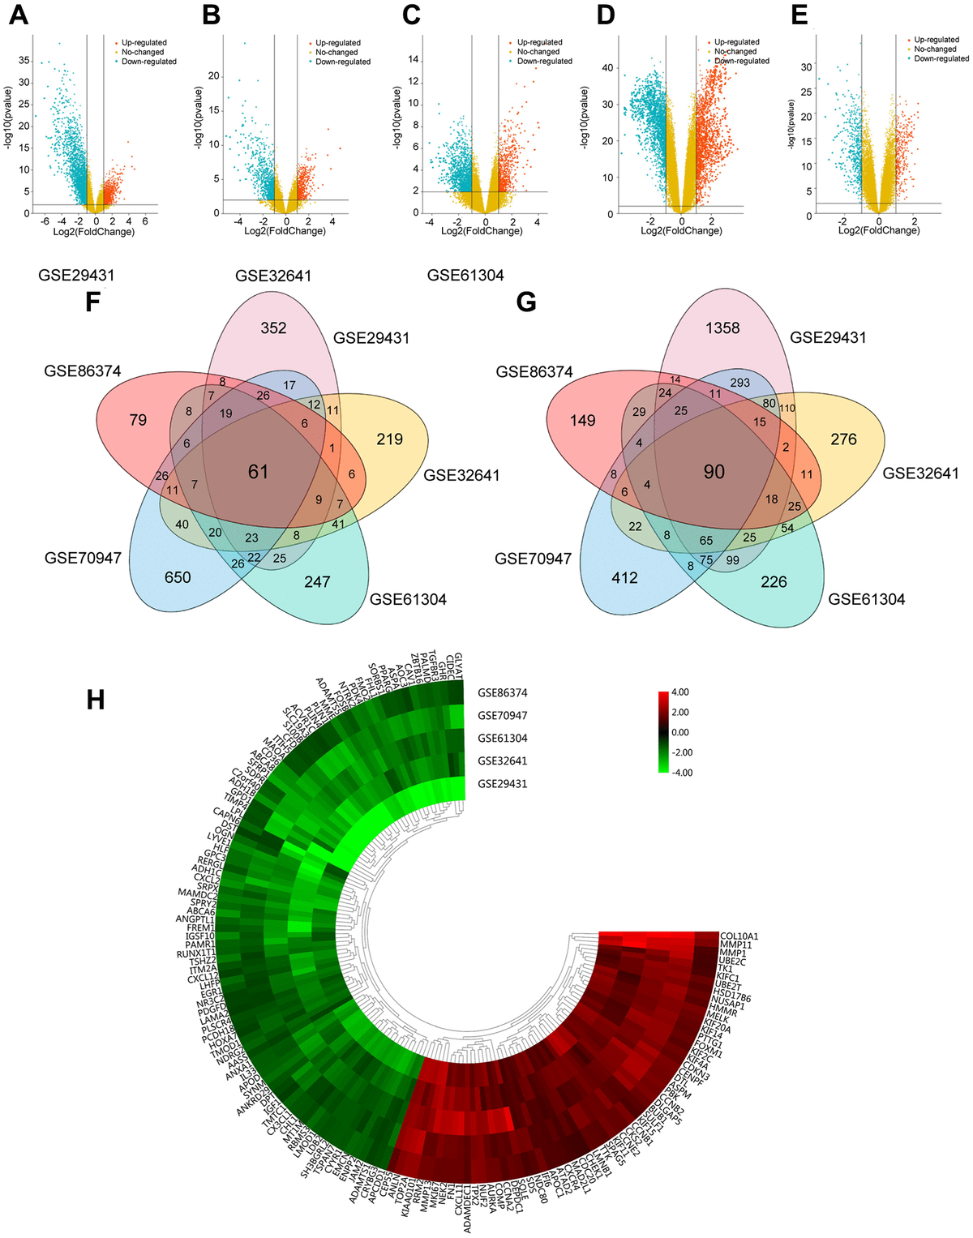
2.2
Explain Question
Provide an explanation of your understanding about this
https://www.aging-us.com/figure/203178/f1
Figure 1. Foundation of DEGs in five GEO databases. (A–E) The display of DEGs in each database by volcano plots. Datasets from GSE29431 (A), GSE32641 (B), GSE61304 (C), GSE70947 (D) and GSE86374 (E). Orange: Up-regulated genes (logFC ≥ 1.0, adj. P < 0.05); Blue: Down-regulated genes (logFC ≤ -1.0, adj. P < 0.05); Yellow: Genes with no significance. (F–G) A Total of 61 significantly upregulated genes (F) and 90 significantly downregulated genes (G) were screened from the five GEO databases. (H) Hierarchical clustering heatmap showed expression of 151 DEGs in five GEO databases. Red: higher expression genes, green: lower expression genes.

Slide 14
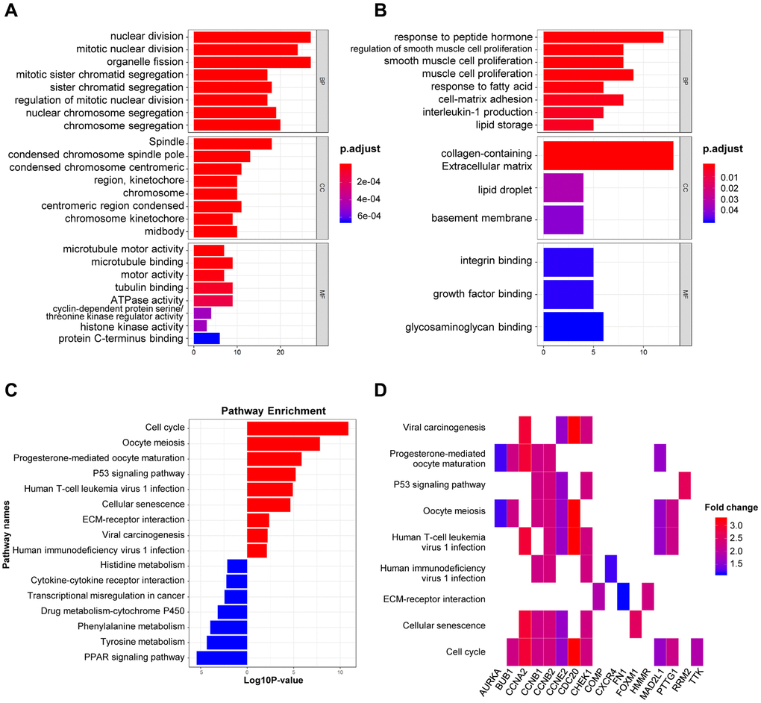
2.3
Explain Question
Provide an explanation of your understanding about this
https://www.aging-us.com/article/203178/text
Figure 2. GO and KEGG analysis of DEGs in BRCA. (A–B) The biological processes, cellular components, and molecular functions of 61 up-regulated DEGs (A) and 90 down-regulated DEGs (B) were displayed by GO analysis. (C) The signaling pathways of 151 DEGs were displayed by KEGG analysis. (D) Heatmap of the significant enrichment results in the KEGG pathway.

Slide 15
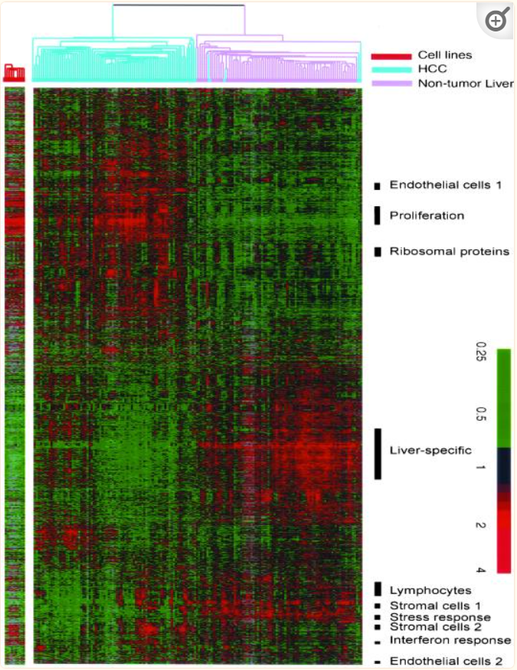
2.4
Explain Question
Provide an explanation of your understanding about this
https://www.ncbi.nlm.nih.gov/pmc/articles/PMC117615/
Figure 1 Hierarchical clustering of the patterns of variation in expression of 3180 genes (represented by 3964 cDNA), in 156 liver tissues (74 nontumor liver and 82 HCC). The data are shown in a table format, in which rows represent individual genes and columns represent individual tissue or cell sample. The color in each cell reflects the expression level of the corresponding gene in the corresponding tissue, relative to its mean expression level across the entire set of tissue samples. The scale extends from fluorescence ratios of 0.25–4 relative to the mean level for all samples. Gray indicates missing or excluded data. Expression of the same genes in 10 HCC cell lines is similarly represented in the panel to the left of the main panel. See supplementary information for the full data, including sample names.

Slide 16
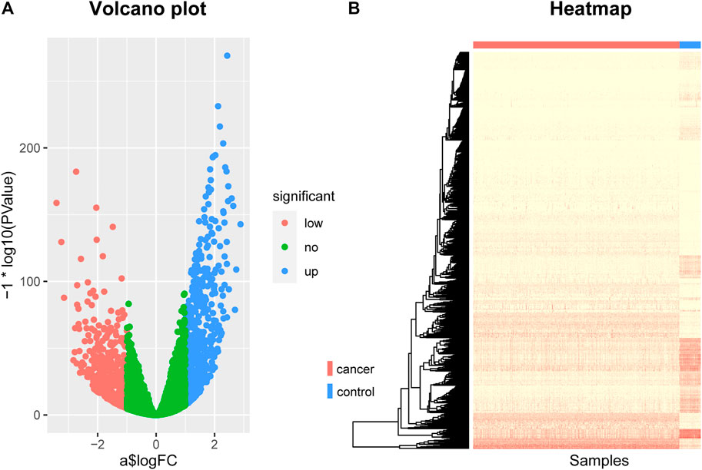
2.5
Explain Question
https://www.frontiersin.org/articles/10.3389/fcell.2021.811585/full
FIGURE 1. The Volcano plot and Heat map of differentially expressed genes. (A) The Volcano plot of differentially expressed genes, where the red dots represent the genes that are down-regulated in breast cancer, the blue dots represent the genes that are up-regulated in breast cancer, and the green dots represent the genes that are not significantly different. (B) The Heat map of differentially expressed genes. The rows represent differentially expressed genes and the columns represent patients, where the red bar represents breast cancer patients and the blue bar represents normal control samples.

Slide 17
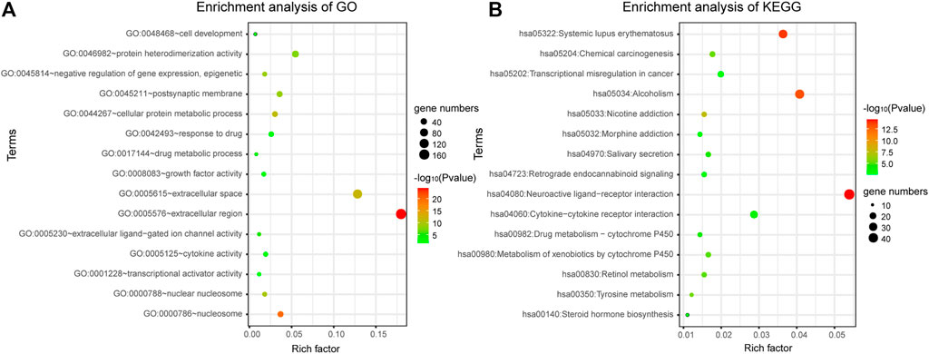
2.6
Explain Question
Provide an explanation of your understanding about this
https://www.frontiersin.org/articles/10.3389/fcell.2021.811585/full
FIGURE 2. Gene enrichment analysis. (A) Gene enrichment analysis of Gene Ontology. (B) Gene enrichment analysis of KEGG.

Slide 18
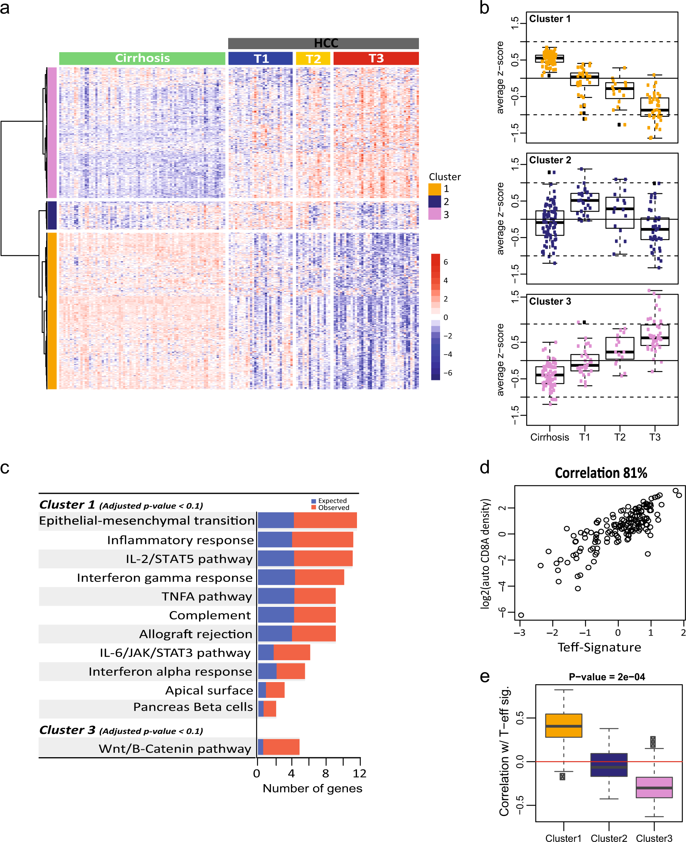
2.7
Explain Question
https://www.nature.com/articles/s41698-018-0068-8/figures/1

Slide 19
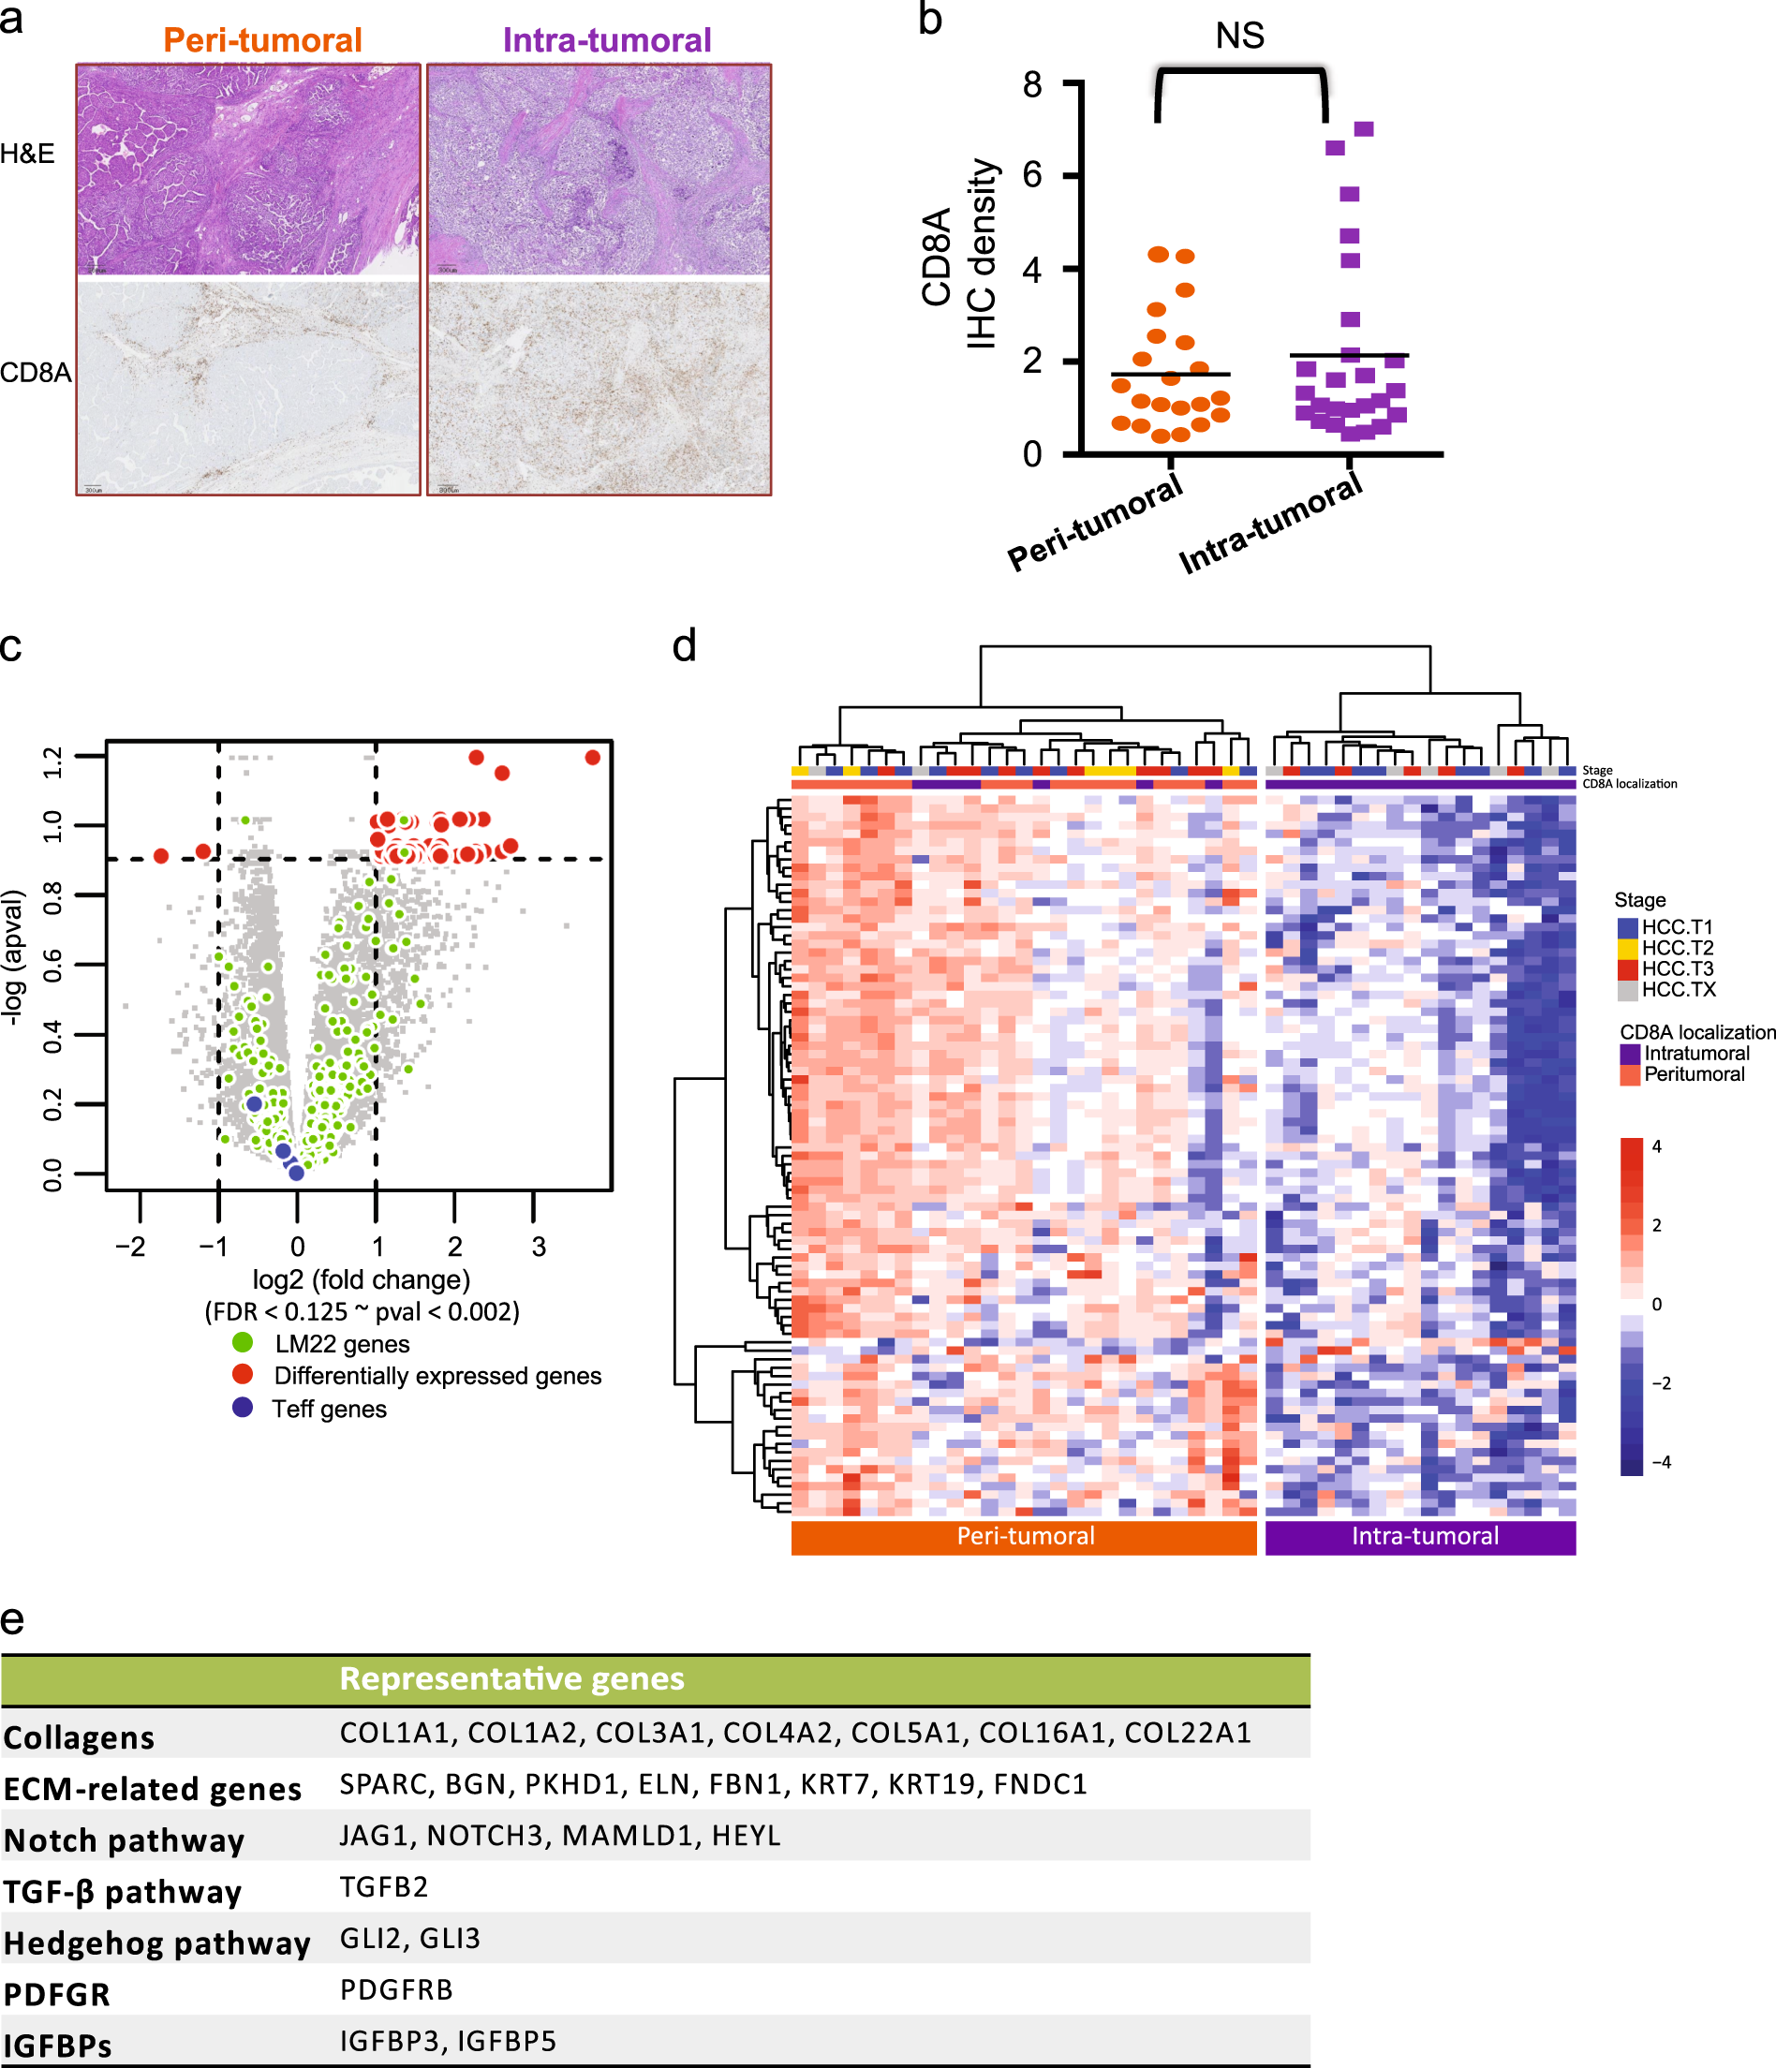
2.8
Explain Question
https://www.nature.com/articles/s41698-018-0068-8/figures/2

